Slide 1
Software Development for the Internet
Java Server Pages

Slide 2
Java Servlets
Java programs that execute inside a web container & handle HTTP requests
"Server side" code
Produces HTML intended for browser consumption and display
javax.servlet & javax.servlet.http

Slide 3
Java Server Pages
Built on top of servlets
A Java Server Page is turned into a servlet (Java program) by the JSP container
HTML with embedded Java code
Response to Active Server Pages (Microsoft)‏
Considered part of J2EE presentation tier

Slide 4
How Does JSP Work?
.jsp file is translated to .java, compiled, & the servlet is executed to provide a response
Subsequent requests are served from memory-resident servlet
JSP translation only occurs if the .jsp file is modified

Slide 5
JSP Advantages
Separate static and dynamic content
Separate content generation from presentation
Platform-neutral
Reusable components
Simple & fast

Slide 6
JSP vs ASP
Wide web server support
Platform independent
Beans, EJBs
Java
Java security model
JDBC data access
Tag libraries
Native with MS-IIS
Fully under Windows; others awkward
Win32 COM
VBScript, Jscript
NT security arch.
Active Data Objects
Not extensible

Slide 7
JSP Basics
Regular text – usually HTML
  Turned into Java output statements
  Executed by the web server
  Net result is to pass it straight to the browser
Java code
  Passed to web server where it is executed
  Output is passed to browser
  Called scriptlet <% …. %>

Slide 8
JSPs, Really
Scriptlets – embedded Java code
Expressions – embedded Java snippets
Directives – JSP parameters or properties
Declarations – out of order methods or variables
JSP tags – HTML-like tags, with attributes

Slide 9
JSP Scriptles
<% ... %>
Well-formed Java statements
Careful of scope

Slide 10
JSP Directives
<%@ … %>
JSP engine or container directives
Specifies how servlet should be built
Produce no output
<%@ page isThreadSafe=false %>
<%@ include file=“stdHeader.html” %>
<%@ page import “java.util.*” %>

Slide 11
Example
<%--This JSP comment starts the file--%>
<%@page contentType="text/html" %>
<html>
<head><title>Simple Text Banner Example One</title></head>
<body>
A very basic JSP page
<div align="center">
<%@page import = "java.util.Random" %>
<%
String ls_Banners[] = {"Mars","Neptune","Saturn","Jupiter"};
Random l_choose = new Random();
out.print(" Visit " + ls_Banners[l_choose.nextInt(4)] );
%>
</div>
</body>
</html>

Slide 12
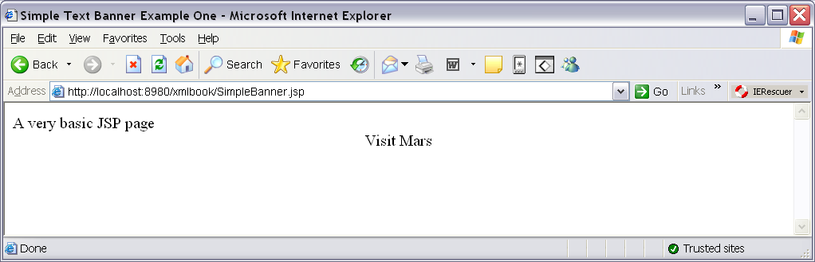
Output From Example

Slide 13
Example with Expression
<HTML>
<HEAD><TITLE>JSP Test</TITLE></HEAD>
<BODY BGCOLOR="#FDF5E6">
<H1>JSP Test</H1>
Time: <%= new java.util.Date() %>
</BODY>
</HTML>
Result of expression evaluation passed directly to browser
No need for output statement

Slide 14
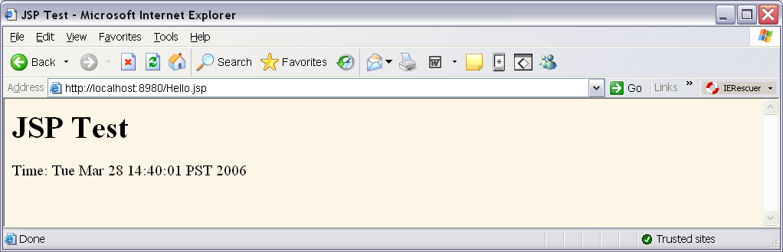
Output from Example with Expression

Slide 15
JSP Implicit Variables
Container
Context
Session
Page
Request
Response

Slide 16
JSP Declarations
<%! … %>
Inserted outside of “service” method
Used for variable declarations and method definitions
  Available across all active instances of JSP page
Eg. <%! public void doMyDBThing() {
// driver, connection, result, blah blah
} %>

Slide 17
JSP Actions
Prepackaged code accessed using XML syntax
Actions include, useBean, setProperty, getProperty, forward and plugin
Example of syntax:
<jsp:include page="news/Item1.html" flush="true"/>

Slide 18
Also Called JSP Tags
<jsp:xxx … />
<jsp:useBean id=“myVar” class=“myClass.class” />
<jsp:getProperty name=“myVar” property=“attrName” />
<jsp:setProperty name=“myVar” property=“attrName” value=“newVal” />
Can build your own actions
  Called tag library

Slide 19
XML Syntax for JSP
JSP page can be written entirely as an XML document
  Original syntax more familiar and easier to code
  XML syntax can be processed using standard XML tools
  .jspx extension instead of .jsp
Example
  <%= … %> would be <jsp:expression … />

